Slide 1

LIBRARY MANAGEMENT SYSTEM
BY
HEAVEN STAY GROUP
P.TEJASWINI
M. POOJITHA
D. BINDHU

Slide 2
About me
Background? (B-tech or M-tech)
Why you want to learn Data Science
Any work experience
Share your LinkedIn and GitHub profile URLs

Slide 3

OBJECTIVE OF THE PROJECT
The main objective of this project is to understand how a library operates by creating and analyzing a complete SQL database.
The project focuses on organizing books, authors, publishers, borrowers, and branch information in a structured way, and then performing SQL queries to study how books are distributed across branches, how borrowers use the library, and how often books are issued.
The goal is to turn raw data into meaningful insights that help improve library management.

Slide 4
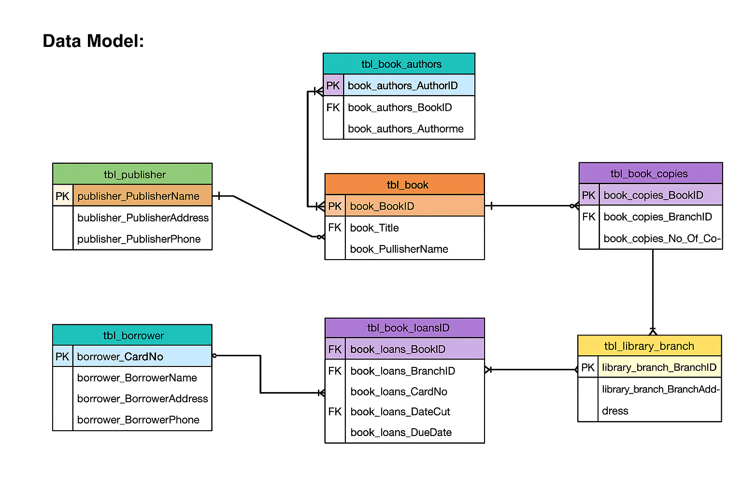
ER DIAGRAM

Slide 5

SCHEMA EXPLANATION
The schema represents the complete relational structure of a Library Management System. It organizes data into 7 related tables, each serving a specific role in managing books, authors, publishers, borrowers, and loan operations.
1. tbl_publisher (Publisher Details):
Stores information about book publishers.
publisher_PublisherName is the Primary Key.
Each publisher can publish multiple books, forming a one-to-many relationship with tbl_book.
2. tbl_book (Book Information)
Contains details about each book in the library.
book_BookID is the Primary Key.
book_PublisherName is a Foreign Key referencing tbl_publisher.
A book can have multiple authors and multiple copies.

Slide 6

3. tbl_book_authors (Authors of Books)
Stores the list of authors for each book.
book_authors_AuthorID is the Primary Key.
book_authors_BookID is a Foreign Key referencing tbl_book.
Supports one-to-many: one book → many authors.
4. tbl_library_branch (Library Branch Information)
Stores each library branch’s name and address.
library_branch_BranchID is the Primary Key.
Each branch can have many copies of books and can issue many loans.
5. tbl_book_copies (Book Inventory Across Branches)
Shows how many copies of each book are available at each branch.
book_copies_CopiesID is the Primary Key.
Contains two Foreign Keys:
  book_copies_BookID → tbl_book
  book_copies_BranchID → tbl_library_branch
Represents a many-to-many relationship between Books and Branches, resolved through this table.

Slide 7

6. tbl_borrower (Borrower Information)
Stores borrower details such as name, address, and phone.
borrower_CardNo is the Primary Key.
Each borrower can check out multiple books.
7. tbl_book_loans (Book Issue Details)
Tracks all issued books and their due dates.
book_loans_LoansID is the Primary Key.
Contains three Foreign Keys:
  book_loans_BookID → tbl_book
  book_loans_BranchID → tbl_library_branch
  book_loans_CardNo → tbl_borrower

Slide 8
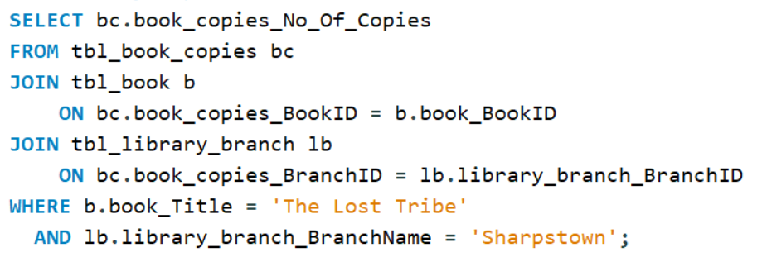

Key analysis questions (use cases)
How many copies of the book titled "The Lost Tribe" are owned by the library branch whose name is "Sharpstown"?

Slide 9
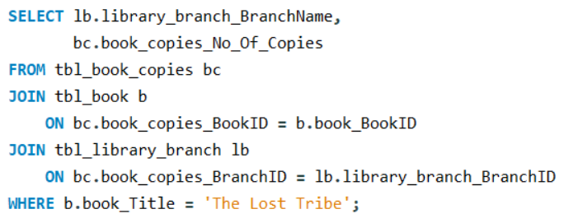
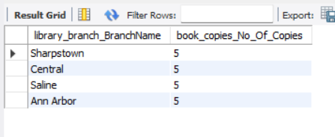
2. How many copies of the book titled "The Lost Tribe" are owned by each library branch?

Slide 10
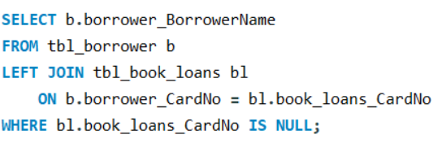

3. Retrieve the names of all borrowers who do not have any books checked out.

Slide 11
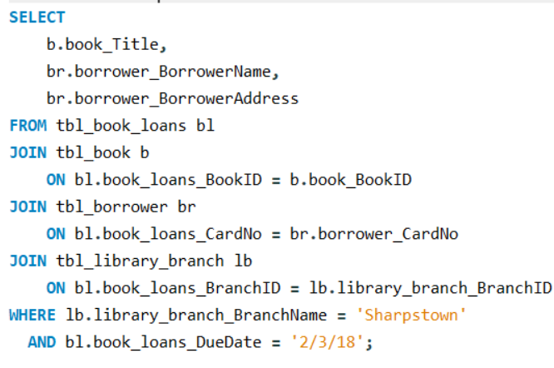
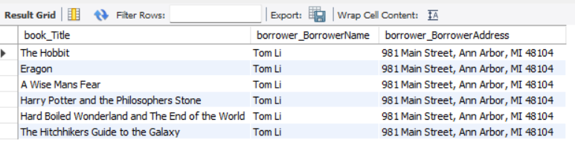
4. For each book that is loaned out from the "Sharpstown" branch and whose Due Date is 2/3/18, retrieve the book title, the borrower's name, and the borrower's address.

Slide 12
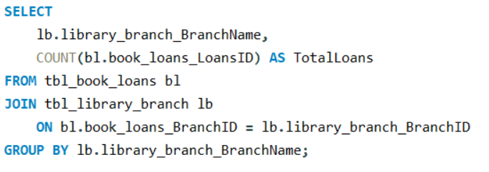
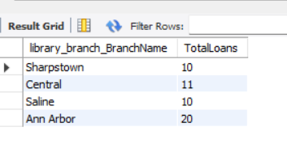
5. For each library branch, retrieve the branch name and the total number of books loaned out from that branch.

Slide 13
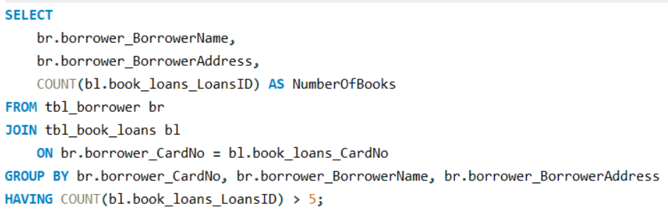
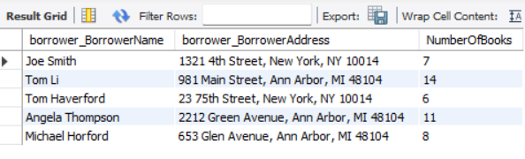
6. Retrieve the names, addresses, and number of books checked out for all borrowers who have more than five books checked out.

Slide 14
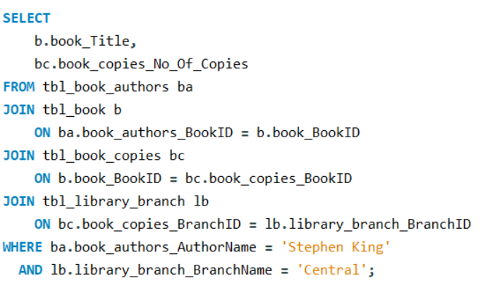

7. For each book authored by "Stephen King", retrieve the title and the number of copies owned by the library branch whose name is "Central".

Slide 15
Final business insights and recommendations
The library data shows clear differences in book demand across branches, with some branches issuing more books than others.
Certain authors and titles are consistently popular, highlighting the need for better inventory planning.
A small group of borrowers accounts for most of the book loans, while others remain inactive.
Book copies are unevenly distributed, causing limited availability in some branches.

Slide 16
CONCLUSION
This project helped in understanding how a library’s data can be effectively managed using SQL. By building the database and running queries on real datasets, we were able to observe trends in book usage, borrower activity, and branch-level performance. The analysis shows how organized data and structured queries can support better decision-making in daily library operations. Overall, the project demonstrates the value of SQL in managing, analyzing, and improving library services.

Slide 17

THANK YOU

